Slide 1
Ecommerce Customers
Project 2

Slide 2
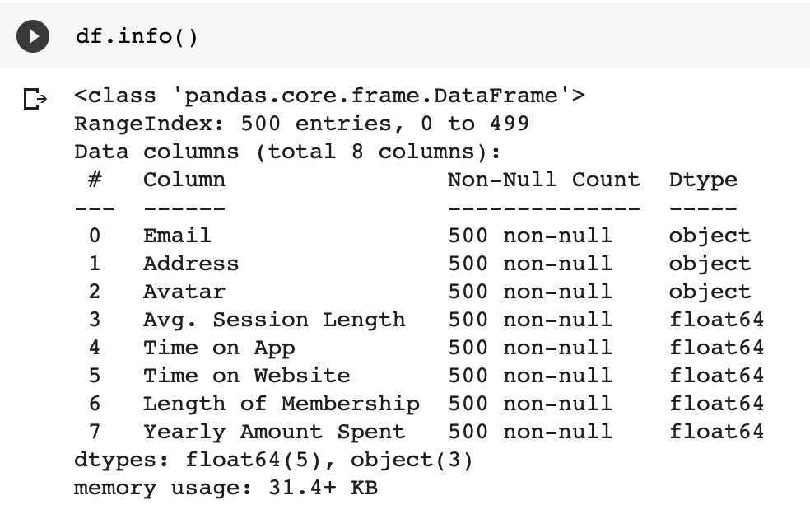
Exploratory Data Analysis (EDA)

Slide 3
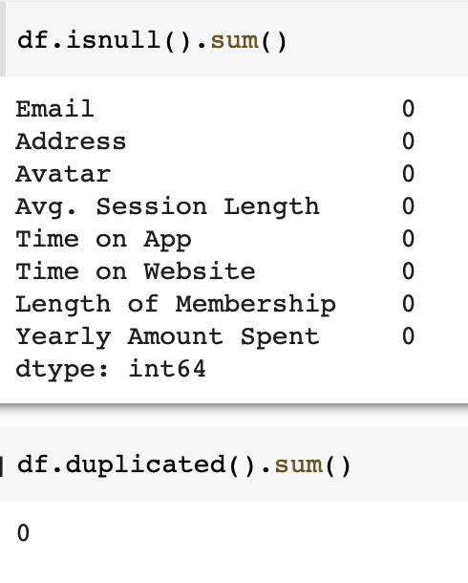
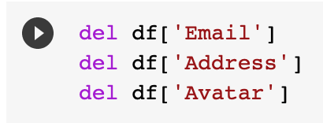
I see no missing values, outliers or duplicated values. Deleting Email, Address and Avatar columns.

Slide 4
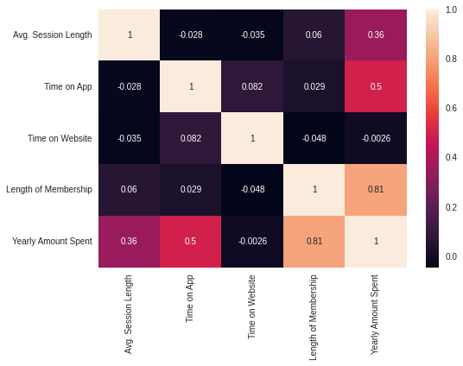
Correlation HeatMap

Slide 5
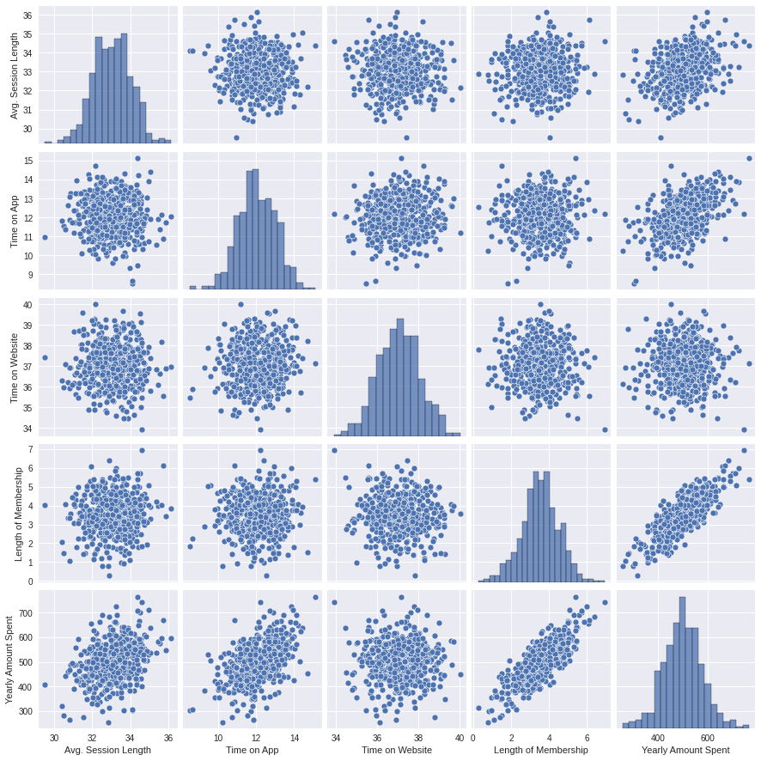
PairPlot helps us to understand the correlations between last two rows between Yearly Amount Spent and Length of Membership as they are Linearly Correlated.

Slide 6
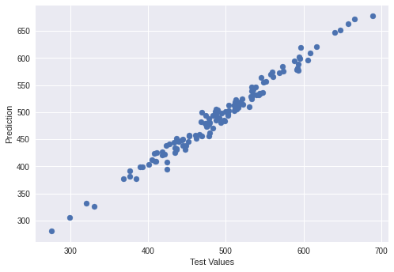
This diagram shows the linearity of the output

Slide 7
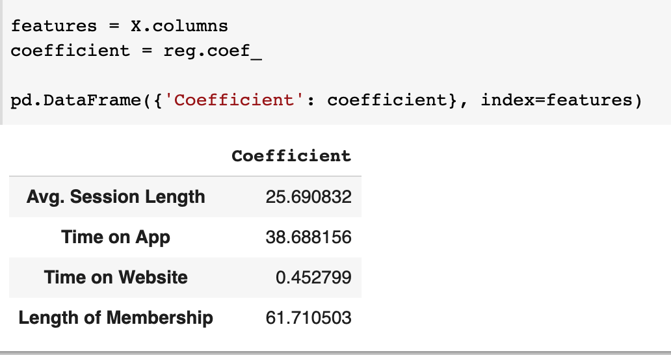
Coefficients indicates the direction of the relationship between a predictor variable and the response variable.

Slide 8
From this Linear Regression Model to predict the annual revenues whether to focus on the app or the website, I see both are not is a great choice to decide. The Length of Membership determines the Annual Revenues.

